Slide 1
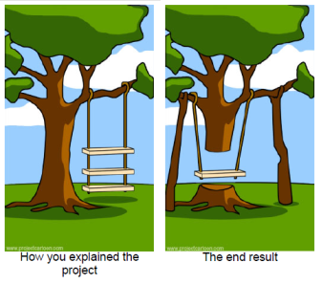
Project Communications Management
School of Computer and Security Science
CSG 2344
Project Methods and Professionalism
ECU Copyright 2015 – CSG 2344 School of Computer and Security Science

Slide 2
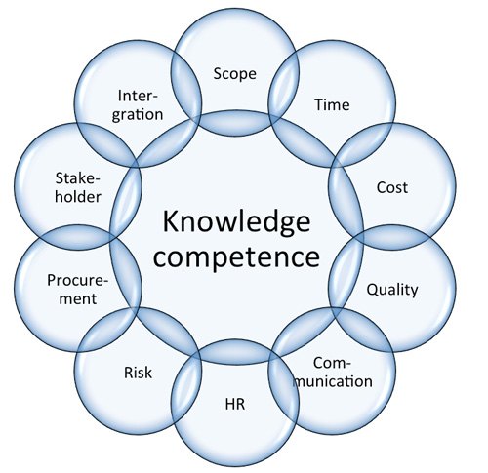
Project Management –
Knowledge Areas
There are Ten Knowledge Management Areas.
(there used to only be 9)
Scope
Time
Cost
Quality
Communications
Risk
Human Resources
Procurement
Stakeholders
Integration
(PMBOK 2015)
ECU Copyright 2015 – CSG 2344 School of Computer and Security Science

Slide 3
Learning Objectives
The importance of good communications in projects
The elements of project communications planning, including how to create a communications management plan & perform a stakeholder communications analysis
Methods for distributing project information and the advantages and disadvantages of each, the importance of addressing individual communication needs, and calculate the number of communications channels in a project.
ECU Copyright 2015 – CSG 2344 School of Computer and Security Science

Slide 4
Learning Objectives (continued)
Understand how the main outputs of performance reporting help stakeholders stay informed about project resources
The importance of good communications management for stakeholder relationships and for resolving issues
Methods for improving project communications, such as managing conflicts, running effective meetings, using e-mail and other technologies effectively, and using templates
How software can enhance communications management
ECU Copyright 2015 – CSG 2344 School of Computer and Security Science

Slide 5
Importance of Good Communications
The greatest threat to many projects is a failure to communicate
Our culture does not portray IT professionals as being good communicators
Research shows that IT professionals must be able to communicate effectively to succeed in their positions
Strong verbal skills are a key factor in career advancement for IT professionals
ECU Copyright 2015 – CSG 2344 School of Computer and Security Science

Slide 6
Project Communications -Management Processes
Communications planning: determining the information and communications needs of the stakeholders
Information distribution: making needed information available to project stakeholders in a timely manner
Performance reporting: collecting and disseminating performance information, including status reports, progress measurement, and forecasting
Managing stakeholders: managing communications to satisfy the needs and expectations of project stakeholders and to resolve issues
ECU Copyright 2015 – CSG 2344 School of Computer and Security Science

Slide 7

Communications Planning
Every project should include some type of communications management plan, a document that guides project communications
Creating a stakeholder analysis for project communications also aids in communications planning
ECU Copyright 2015 – CSG 2344 School of Computer and Security Science

Slide 8
Communications Management
Plan Contents
Stakeholder communications requirements
Information to be communicated, including format, content, and level of detail
The people who will receive the information and who will produce it
Suggested methods or technologies for conveying the information
ECU Copyright 2015 – CSG 2344 School of Computer and Security Science

Slide 9
Communications Management
Plan Contents (continued)
Frequency of communication
Escalation procedures for resolving issues
Revision procedures for updating the communications management plan
A glossary of common terminology
ECU Copyright 2015 – CSG 2344 School of Computer and Security Science

Slide 10
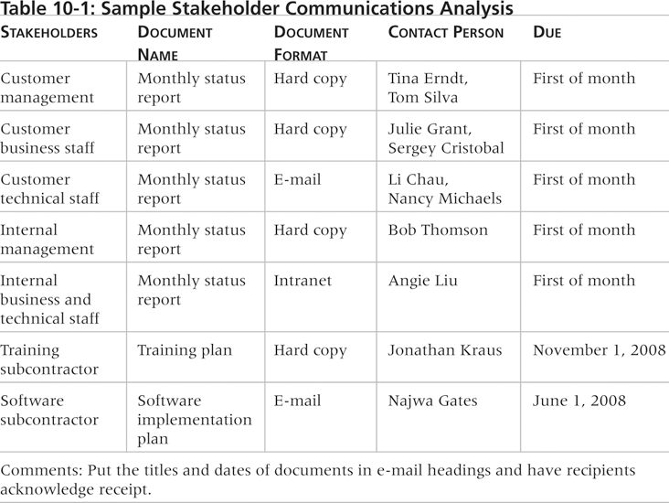
Sample Stakeholder Analysis for Project Communications

Slide 11
Information Distribution
Getting the right information to the right people at the right time and in a useful format is just as important as developing the information in the first place
Important considerations include:
  Using technology to enhance information distribution
  Formal and informal methods for distributing information
ECU Copyright 2015 – CSG 2344 School of Computer and Security Science

Slide 12
What Went Wrong?
Telecommunications throughout Asia were severely disrupted on December 26, 2006, after earthquakes off Taiwan damaged undersea cables, slowing Internet services and hindering financial transactions, particularly in the currency market
International telephone traffic was restricted from some countries, and Internet access slowed to a crawl
ECU Copyright 2015 – CSG 2344 School of Computer and Security Science

Slide 13
Distributing Information in an Effective and Timely Manner
Don’t bury crucial information
Don’t be afraid to report bad information
Oral communication via meetings and informal talks helps bring important information—good and bad—out into the open
ECU Copyright 2015 – CSG 2344 School of Computer and Security Science

Slide 14
Importance of Face-to-Face Communication
Research says that in a face-to-face interaction:
  58 percent of communication is through body language
  35 percent of communication is through how the words are said
  7 percent of communication is through the content or words that are spoken
Pay attention to more than just the actual words someone is saying
A person’s tone of voice and body language say a lot about how he or she really feels
ECU Copyright 2015 – CSG 2344 School of Computer and Security Science

Slide 15
Encouraging More Face-to-Face Interactions
Short, frequent meetings are often very effective in IT projects
Stand-up meetings force people to focus on what they really need to communicate
Some companies have policies preventing the use of e-mail between certain hours or even entire days of the week
ECU Copyright 2015 – CSG 2344 School of Computer and Security Science

Slide 16
Understanding Group and Individual Communication Needs
People are not interchangeable parts
As illustrated in Brooks’ book The Mythical Man-Month, you cannot assume that a task originally scheduled to take two months of one person’s time can be done in one month by two people
Nine women cannot produce a baby in one month!
ECU Copyright 2015 – CSG 2344 School of Computer and Security Science

Slide 17
Personal Preferences Affect Communication Needs
Introverts like more private communications, while extroverts like to discuss things in public
Intuitive people like to understand the big picture, while sensing people need step-by-step details
Thinkers want to know the logic behind decisions, while feeling people want to know how something affects them personally
Judging people are driven to meet deadlines, while perceiving people need more help in developing and following plans
ECU Copyright 2015 – CSG 2344 School of Computer and Security Science

Slide 18

Other Communication Considerations
Rarely does the receiver interpret a message exactly as the sender intended
Geographic location and cultural background affect the complexity of project communications
  Different working hours
  Language barriers
  Different cultural norms
ECU Copyright 2015 – CSG 2344 School of Computer and Security Science

Slide 19
Setting the Stage for Communicating - Bad News
Dear Mom and Dad, or should I say Grandma & Grandpa,
Yes, I am pregnant. No, I’m not married yet since Larry, my boyfriend, is out of a job. Larry’s employers just don’t seem to appreciate the skills he has learned since he quit high school. Larry looks much younger than you, Dad, even though he is three years older. I’m quitting college and getting a job so we can get an apartment before the baby is born. I found a beautiful apartment above a 24-hour auto repair garage with good insulation so the exhaust fumes and noise won’t bother us.
I’m very happy. I thought you would be too.
Love, Ashley
P.S. There is no Larry. I’m not pregnant. I’m not getting married. I’m not quitting school, but I am getting a “D” in Chemistry. I just wanted you to have some perspective.
ECU Copyright 2015 – CSG 2344 School of Computer and Security Science

Slide 20

Determining number of Communications Channels
As the number of people involved increases, the complexity of communications increases because there are more communications channels or pathways through which people can communicate
Number of communications channels = n(n-1)
2
where n is the number of people involved
ECU Copyright 2014 – CSG 2344 School of Computer and Security Science

Slide 21
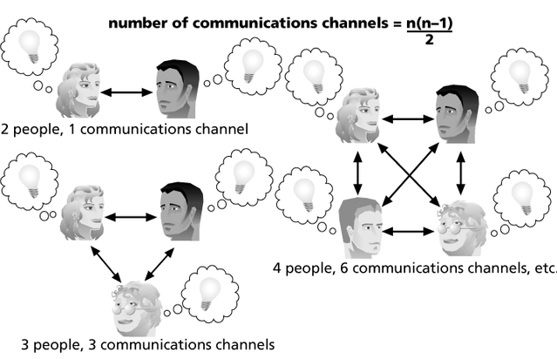
The Impact of the Number of People on Communications Channels
ECU Copyright 2015 – CSG 2344 School of Computer and Security Science

Slide 22
Performance Reporting
Performance reporting keeps stakeholders informed about how resources are being used to achieve project objectives
  Status reports describe where the project stands at a specific point in time
  Progress reports describe what the project team has accomplished during a certain period of time
  Forecasts predict future project status and progress based on past information and trends
ECU Copyright 2015 – CSG 2344 School of Computer and Security Science

Slide 23

Managing Stakeholders
Project managers must understand and work with various stakeholders
Need to devise a way to identify and resolve issues
Two important tools include:
  Expectations management matrix
  Issue log
ECU Copyright 2015 – CSG 2344 School of Computer and Security Science

Slide 24

Suggestions for Improving Project Communications
Manage conflicts effectively
Develop better communication skills
Run effective meetings
Use e-mail and other technologies effectively
Use templates for project communications
ECU Copyright 2015 – CSG 2344 School of Computer and Security Science

Slide 25
Conflict Handling Modes
Confrontation: directly face a conflict using a problem-solving approach
Compromise: use a give-and-take approach
Smoothing: de-emphasize areas of difference and emphasize areas of agreement
Forcing: the win-lose approach
Withdrawal: retreat or withdraw from an actual or potential disagreement
ECU Copyright 2015 – CSG 2344 School of Computer and Security Science

Slide 26
Conflict Can Be Good
Conflict often produces important results, such as new ideas, better alternatives, and motivation to work harder and more collaboratively
Groupthink: conformance to the values or ethical standards of a group; groupthink can develop if there are no conflicting viewpoints
Research suggests that task-related conflict often improves team performance, but emotional conflict often depresses team performance
ECU Copyright 2015 – CSG 2344 School of Computer and Security Science

Slide 27
Developing Better Communication Skills
Companies and formal degree programs for IT professionals often neglect the importance of speaking, writing, and listening skills
As organizations become more global, they realize they must invest in ways to improve communication with people from different countries and cultures
It takes leadership to improve communication
ECU Copyright 2015 – CSG 2344 School of Computer and Security Science

Slide 28
Running Effective Meetings
Determine if a meeting can be avoided
Define the purpose and intended outcome of the meeting
Determine who should attend the meeting
Provide an agenda to participants before the meeting
Prepare handouts and visual aids, and make logistical arrangements ahead of time
Run the meeting professionally
Build relationships
ECU Copyright 2015 – CSG 2344 School of Computer and Security Science

Slide 29
Using E-Mail, Instant Messaging, and Collaborative Tools Effectively
Make sure that e-mail, instant messaging, or collaborative tools are an appropriate medium for what you want to communicate
Be sure to send information to the right people
Use meaningful subject lines and limit the content of emails to one main subject, and be as clear and concise as possible
Be sure to authorize the right people to share and edit your collaborative documents
ECU Copyright 2015 – CSG 2344 School of Computer and Security Science

Slide 30
Best Practice
In June 2006, CIO magazine surveyed information technology executives on their best practices for managing innovation in business
When asked what technologies they plan to implement or leverage in the coming year:
  54 percent of respondents reported handheld PCs/PDAs as the most important hardware
  56 percent cited Web services as the most important software
  53 percent cited wireless technologies as the most important Internet technology
these technologies will help organizations improve communications by allowing workers to communicate any time and anywhere
ECU Copyright 2015 – CSG 2344 School of Computer and Security Science

Slide 31
Using Templates for Project Communications
Many technical people are afraid to ask for help
Providing examples and templates for project communications saves time and money
Organizations can develop their own templates, use some provided by outside organizations, or use samples from textbooks
Recall that research shows that companies that excel in project management make effective use of templates
ECU Copyright 2015 – CSG 2344 School of Computer and Security Science

Slide 32
Lessons Learned Reports
The project manager and project team members should each prepare a lessons-learned report
  A reflective statement that documents important things an individual learned from working on the project
The project manager often combines information from all of the lessons-learned reports into a project summary report
ECU Copyright 2015 – CSG 2344 School of Computer and Security Science

Slide 33
Project Archives
It is also important to organize and prepare project archives
Project archives are a complete set of organized project records that provide an accurate history of the project
These archives can provide valuable information for future projects as well
ECU Copyright 2015 – CSG 2344 School of Computer and Security Science

Slide 34
Project Web Sites
Many project teams create a project Web site to store important product documents and other information
Can create the site using various types of software, such as enterprise project management software
ECU Copyright 2015 – CSG 2344 School of Computer and Security Science

Slide 35
Using Software to Assist in Project Communications
There are many software tools to aid in project communications
Today, many people telecommute or work remotely at least part-time
Project management software includes new capabilities to enhance virtual communications
New tools, such as instant messaging and blogs, can enhance project communications
ECU Copyright 2015 – CSG 2344 School of Computer and Security Science

Slide 36

Chapter Summary
The goal of project communications management is to ensure timely and appropriate generation, collection, dissemination, storage, and disposition of project information
Main processes include:
  Communications planning
  Information distribution
  Performance reporting
  Managing stakeholders
ECU Copyright 2015 – CSG 2344 School of Computer and Security Science

